Slide 1
Mini Lesson-5
When did the trails begin and end?

Slide 2
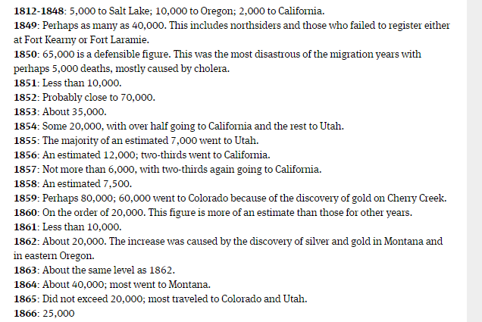
Notes:
Overall timeline, not separated by destination.

Slide 3
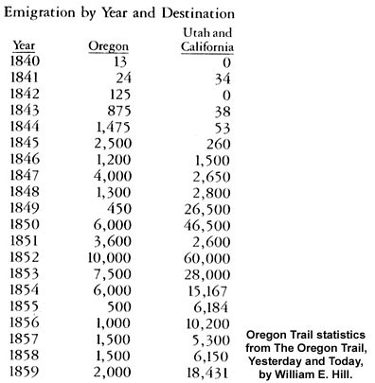
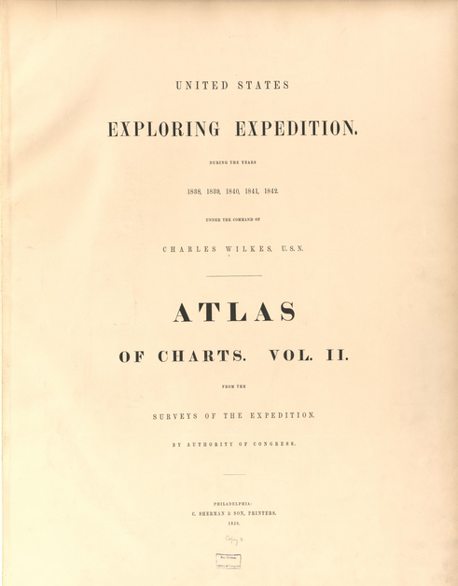
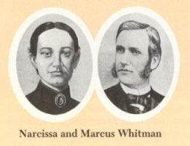
Oregon Trail
Notes:
Oregon trail begins with government surveying expeditions between 1832 and 1834, published in 1838. Expeditions by missionaries like the Whitmans brought more attention to the territory. The Oregon trail declined significantly as railroads headed west or more compelling options (like California) emerged.

Slide 4
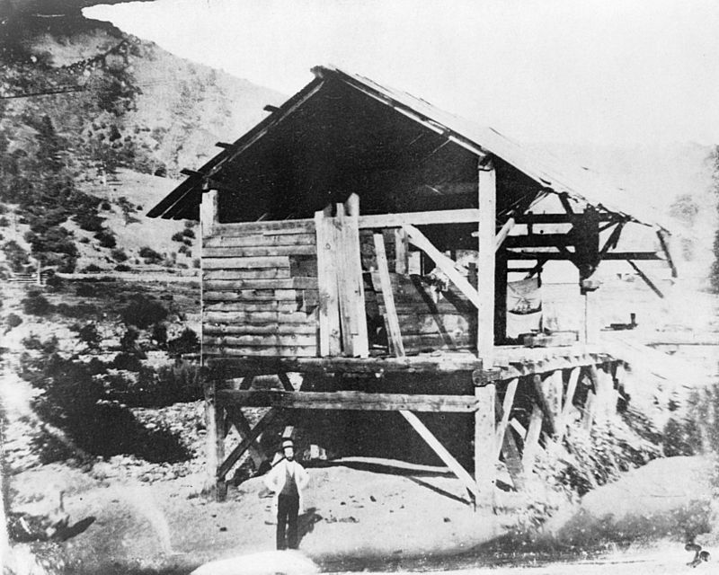
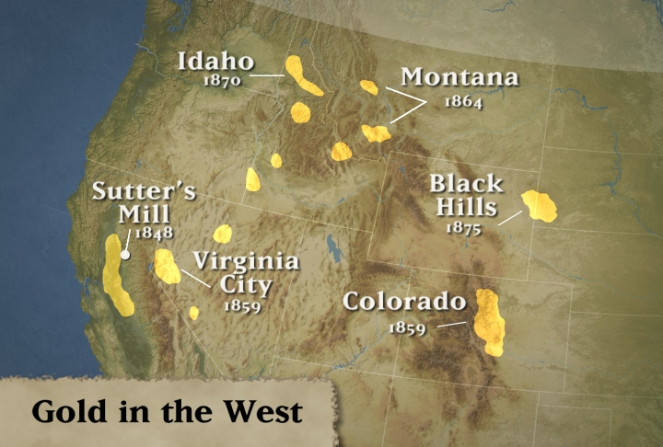
California Trail
Notes:
Gold was first discovered at Sutter’s Mill in California on January 24, 1848 by James Marshall.The following year saw the 49ers pour across the plains towards California.
Travel shifted as fields played out in California and gold and silver were found in other places like Colorado, Arizona, Montana, South Dakota . .

Slide 5
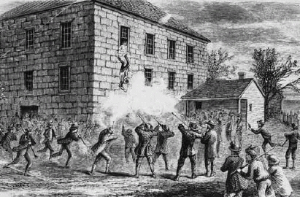
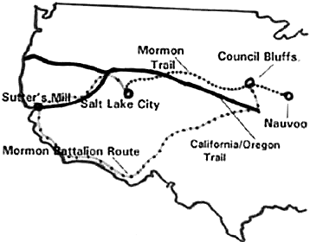
Utah Trail
Notes:
The Mormon migration began in 1846-47 two years after Joseph Smith and his brother were killed in Carthage, Missouri. Previously they had been run out of Missouri in 1838. Why would the Mormon group choose the Salt Lake Valley to settle?

