Slide 1
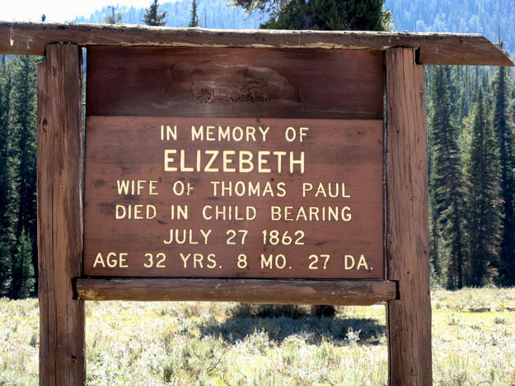
Who Went West?

Slide 2
What kinds of people would most likely leave everything and head West?

Slide 3
Review your journal
What is the destination of your journal’s travelers?
Based on what you have read so far total the types of people mentioned in the journal.
How many:
men
women
children

Slide 4
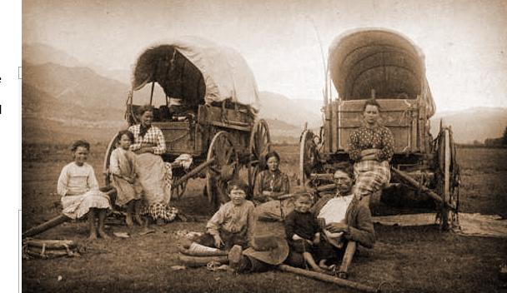
Who went to Oregon?
Men
Women
Children
Notes:
Collect responses from students and total on the slide-
Is this photo accurate?

Slide 5
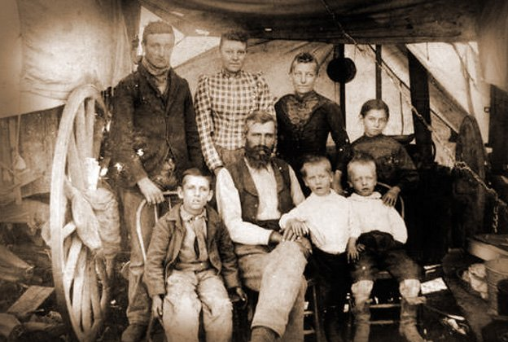
Who went to California?
Men
Women
Children
Notes:
Collect responses from students and total on the slide
Is this photo accurate?

Slide 6
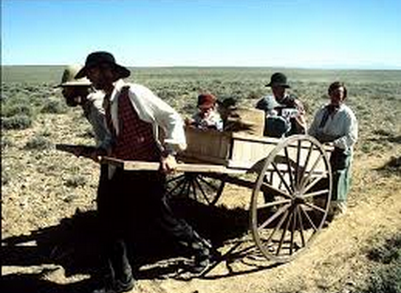
Who went to Utah?
Men
Women
Children
Notes:
Collect responses from students and total on the slide
Is this photo accurate?

Slide 7
Explain the makeup of pioneers going to different destinations

Slide 8
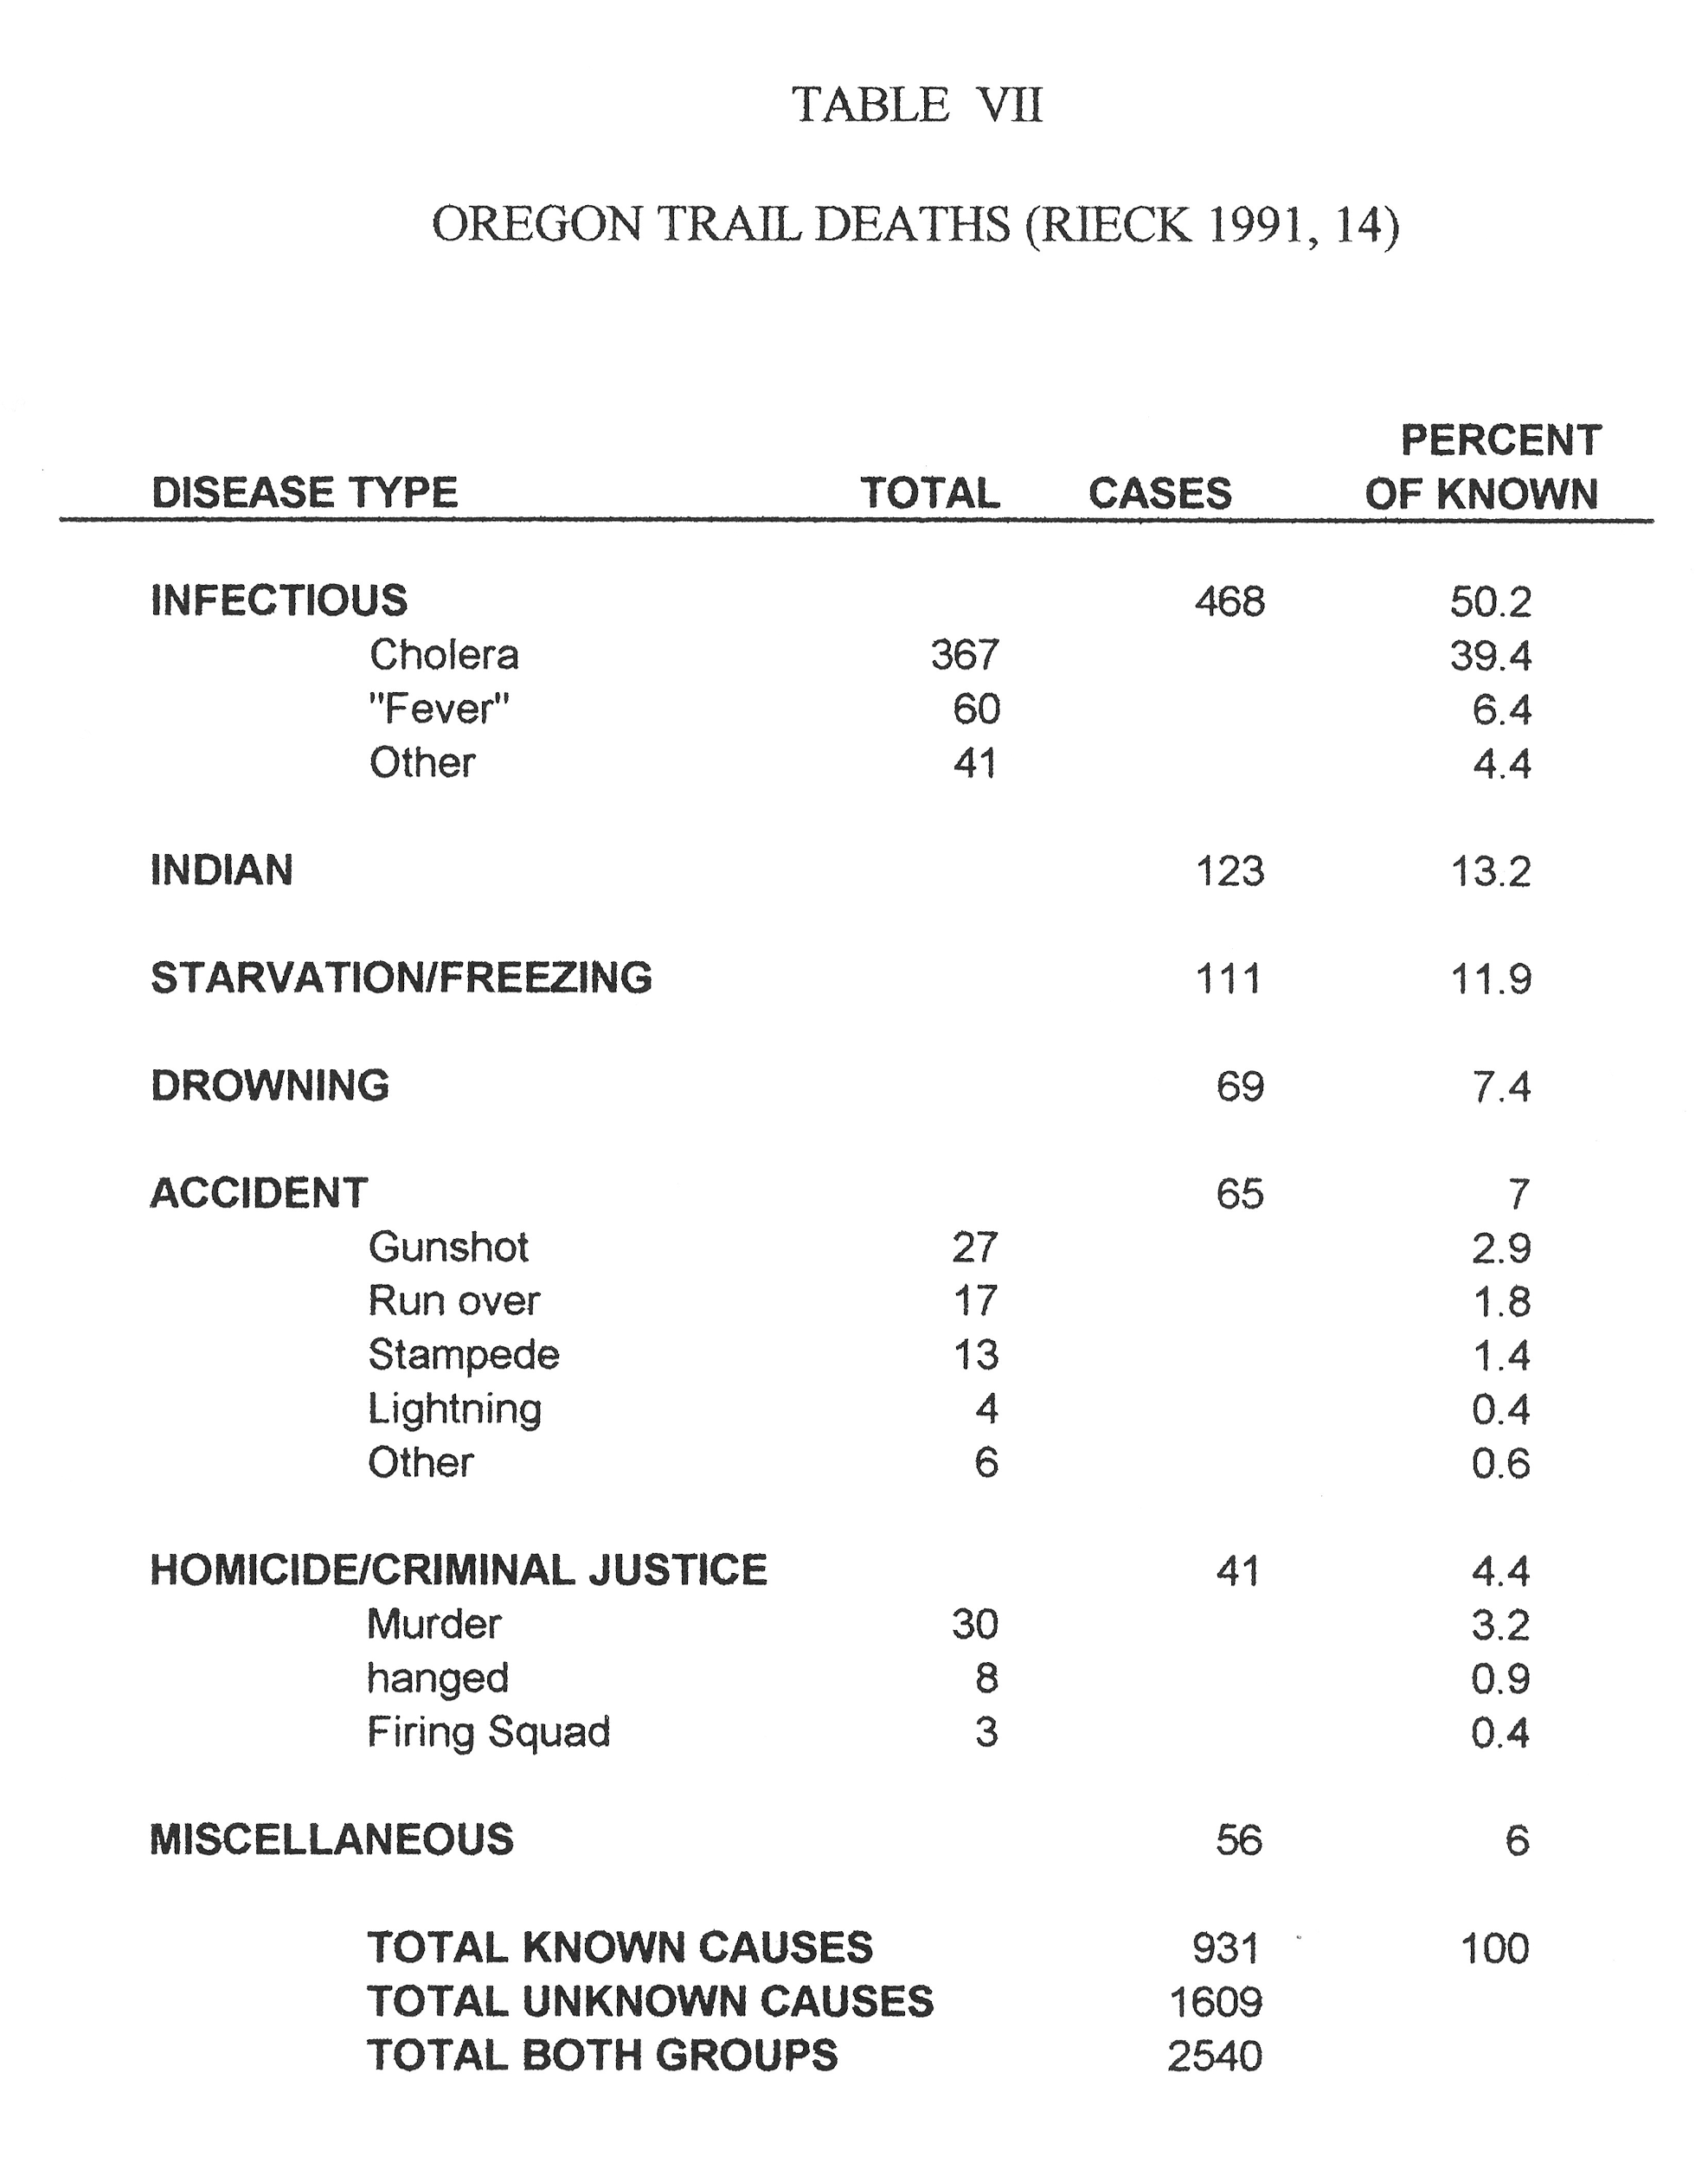
How and why did people die on their way West?

