Slide 1
The Role of Independence in Westward Expansion
Learning Target- I can explain the role of Independence as the “Queen City of the trails”

Slide 2
400,000
people traveled westward on trails between 1840 and 1860
About 40,000 of them died along the journey.

Slide 3
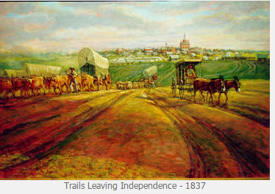
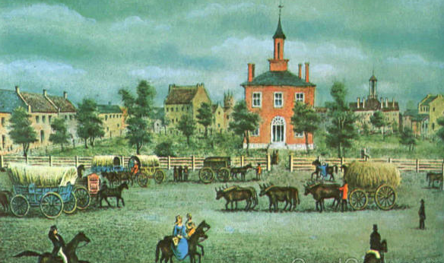
Compare these paintings of Independence. What hints do they give us about Independence at this time?
Notes:
What might we recognize today in these pictures?

Slide 4
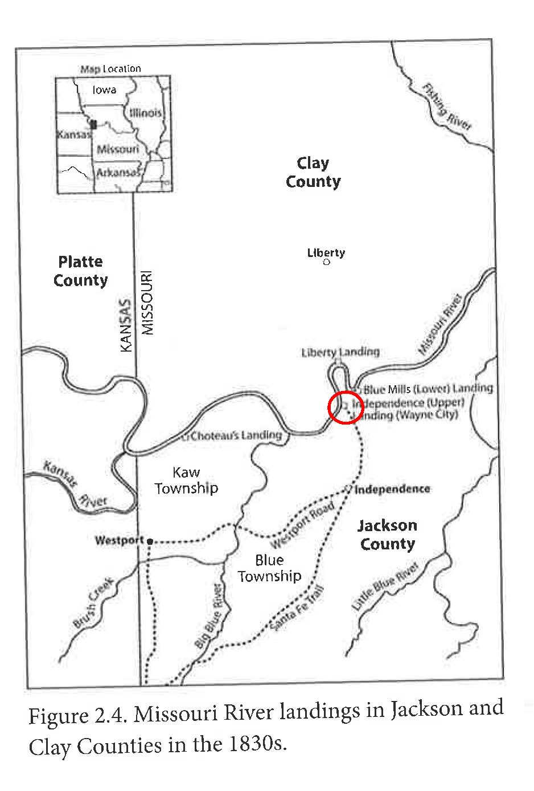
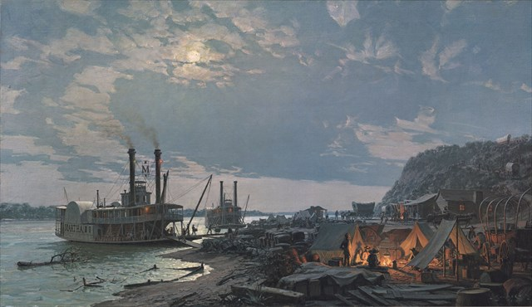
How did pioneers get to Independence?
Notes:
When we go to the field trip, we will visit the place shown in this picture. At this time, steamboats found a gravel bar on the Missouri River that worked well as a landing site. It is just upstream from the 291 Bridge is today. Pioneers got off the steamboat here and went down “river street” all the way to the Independence Square.

Slide 5
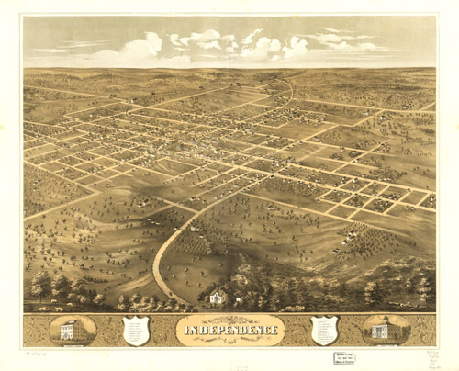
What did Pioneers do in Independence?
Notes:
Click image for annotated map. Consider using technology to allow students to research facts about early Independence to share with the class.
Trail facts- http://www.ci.independence.mo.us/NFTM/TrailFacts

Slide 6
How was Independence affected by this migration of people?
Notes:
article- http://www.octa-trails.org/articles/independence-missouri

Slide 7
What was the psychological importance of Independence?

Slide 8
In your journal, what was the “jumping off place” for these travelers? What does the journal say about this place?

