Slide 1
Why go west?
Learning Target- today I will examine sources to assess the reasons why people voluntarily left their homes and went west.

Slide 2
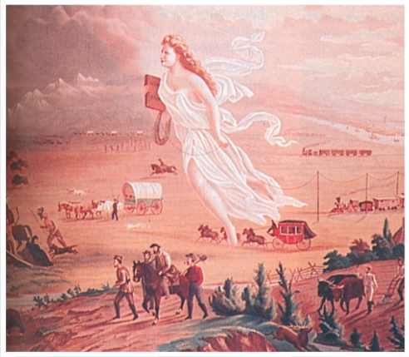
John Gast, American Progress, 1872
Notes:
Examine this painting. What do you notice is included in the painting? If each detail were a symbol, what would each represent?
What is the message of this painting? How is it relevant to today’s learning target?

Slide 3
Why go West?
There’s no single answer to this question. Instead, we will take a quick look at the things that may have influenced people
Notes:
http://www.history.com/topics/inventions/transcontinental-railroad/videos/transcontinental-railroad
http://imnh.isu.edu/digitalatlas/geog/explore/images/stats1.jpg

Slide 4
In your class notebook create this organizer-
Reason for going west | Details/ Examples
Notes:
With each slide, slides quickly share the information, then let the students come up with a category for that information. Details from a slide will either go with an existing category or become a new category.
For fortune-
The Santa Fe Trail established a trade with the Spanish SW, trading manufactured good from the US for Spanish Silver.
The California Trail led people to the goldfields of California
For adventure?
To start a new life
The Oregon Trail led people to places where they might find land and establish farms and towns.
Manifest Destiny
People looked at the lands to the west and felt they should be part of the US. But empty land must be claimed by having people move there.
Americans had a sense of manifest destiny a belief in the unique status of America as a free country, blessed by God

Slide 5
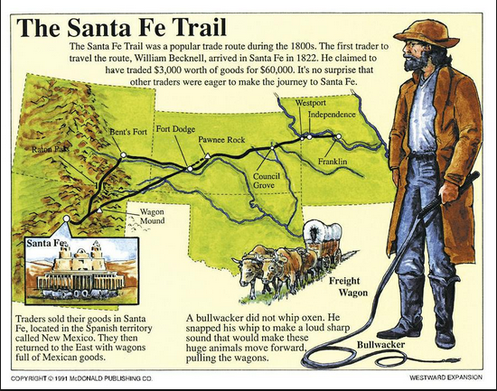
Why did people travel the Santa Fe Trail?

Slide 6
In your class notebook create this organizer-
Reason for going west | Details/ Examples
For fortune/ to make money | The Santa Fe Trail established a trade with the Spanish SW, trading manufactured good from the US for Spanish Silver. Traders went between Independence and Sante Fe with wagons filled with goods.
Notes:
With each slide, slides quickly share the information, then let the students come up with a category for that information. Details from a slide will either go with an existing category or become a new category.
example to guide students to fill out the organizer

Slide 7
Why did people travel the Oregon Trail?
Nicholas and Maria Spenger traveled to Oregon with nine children

Slide 8
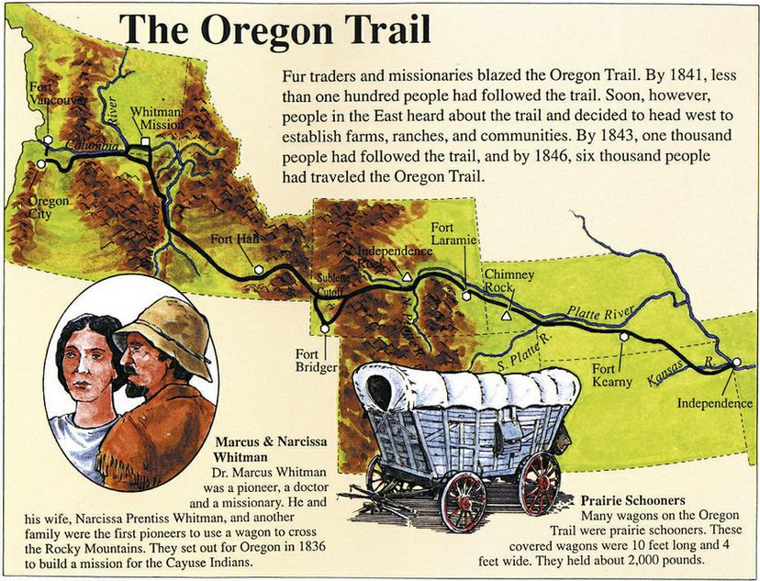
Why did people travel the Oregon Trail?

Slide 9
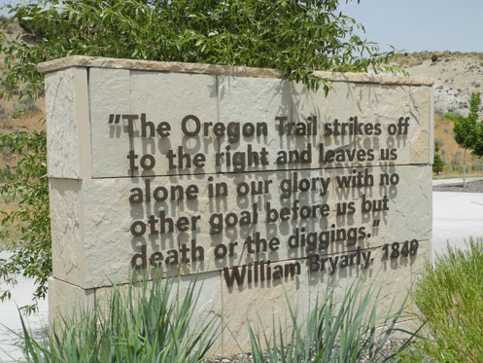
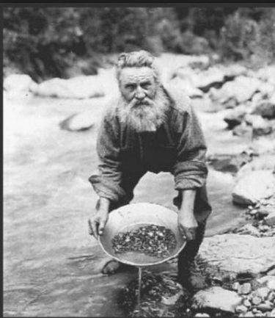
Why did people travel the California Trail?

Slide 10
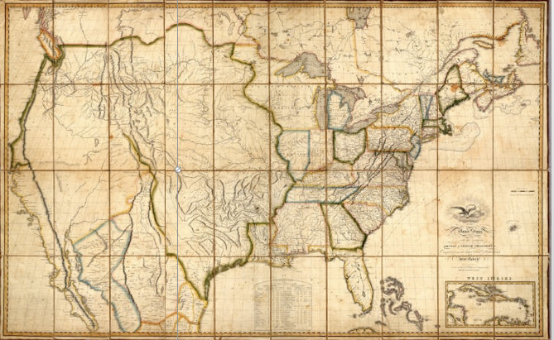
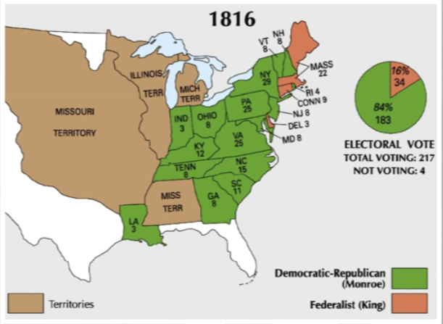
1816 Map of the US with contiguous British and Spanish possessions
Notes:
Invite students to carefully make observations about the map on the right. What do they notice? How does it compare with the maps on the left? What is different and similar?
in 1816, the US was made up only of states east of the Mississippi River (except for Louisiana) and the newly purchased territory. However the 1816 map to the right shows the whole continent. Why draw a map of the US and include lands that are owned by Britain and Spain? Why is there no clear boundary in the West showing where the US ends?

Slide 11
Notes:
Comments of the creator of the 1816 map. What was he thinking as he created the map? How did people in the US view lands to the West?

Slide 12
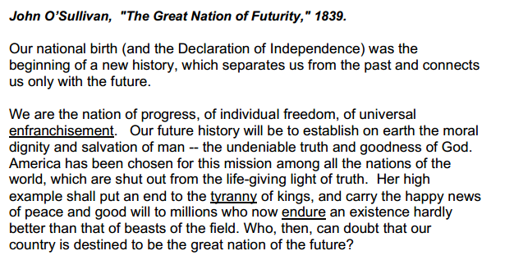
Notes:
If there is time, consider printing this excerpt and having students annotate it. What is the main idea of this source? How does it explain “Manifest Destiny?”

Slide 13
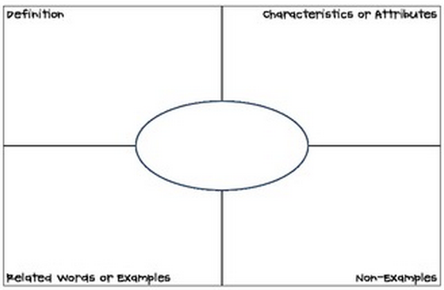
Manifest
Destiny
Notes:
Use the Great Nation of Futurity excerpt to help develop a class definition of Manifest Destiny.

Slide 14
As you read your journal today, look for clues as to why that individual or family went west.

Slide 15
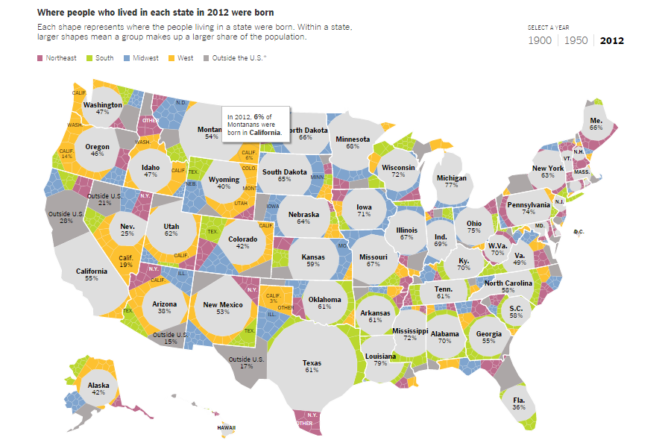
Are we a nation of movers?

