Slide 1
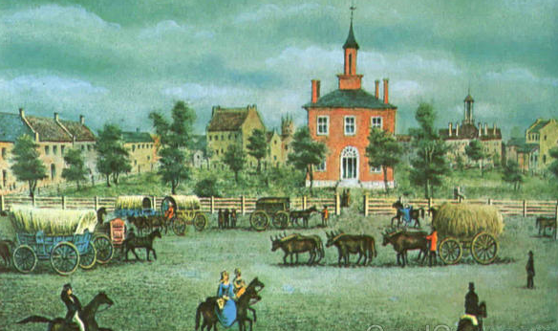
Pioneer Journal Project

Slide 2
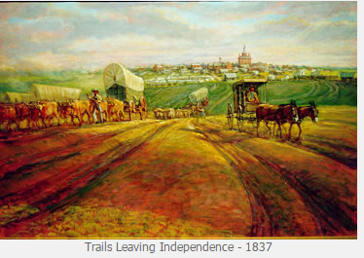
Notes:
Close view image

Slide 3
Laying out the project- following the C3 Framework
EQ- How did the idea of Manifest Destiny transform the United States?
Developing and Planning the Inquiry | Applying History tools and perspectives | Evaluating sources and using evidence | Communicating Conclusions
Establish a basic foundation of Westward expansion and what students really know about specifics from that time period. Explore questions about why people migrate from one place to another. Use mini lessons for teachers to use each day for background information | Students will close read a unique pioneer journal over the course of 5-10 school days. Students will use tools to record specific details from their journal. Teachers will need to notice struggles and questions and use these to intervene with short “teaching moments” | In small groups, students synthesize evidence they collected in preparation for a final project. | Placeholder for a culminating project Students transfer themes of the pioneer journals to their own lives and practice journaling
Notes:
copy for teachers

Slide 4
Consider this typical lesson progression for the duration of the project:
Mini lesson of the day: 5-10 min.
Establish a purpose for reading. What did we notice yesterday in our journals? 5 min (Interesting content, things we didn’t understand, vocabulary wall)
Work time for reading journals: 20-25 min
Debrief- whole class reflection on the day’s work: 5 min
Notes:
Modify based on your school’s schedule and the needs of your students.

Slide 5
Mini Lessons?
5-10 minutes each day
The Allure of the West: Why Go?
The Geography of Westward Expansion: Where did they go?
Independence: What did Pioneers see and do here?
The Pioneers: Who went West?
Timeline: When did the Westward movement begin and end?
Notes:
Santa Fe Trade - Gold Rush (Colorado and California) - New Beginnings - Free Land - Escape From Disease - Religion -
Resources- “Stories of Young Pioneers~ In Their Own Words” Violet T. Kimball

Slide 6
2. Establish a purpose for reading-
Look for themes mentioned in the Mini-Lesson
Focus on items the class struggled with previously.
Apply specific strategies to journals
Develop a profile of the author.

Slide 7
3. Close Reading the Journals (Students)
How will students actively read the journals?
Set goals (2-3 pages a day)
Mark up the journal as they read
Use the finding aid template to record certain details.
Record the themes of the content (purpose of the journal, emotions, kinds of details shared)
Notes:
Still working on template

Slide 8
Work time support (teacher)
Create an early 1800’s word wall- any word we don’t normally use in 2015, along with a definition.
Circulate during reading time, individually working with struggling readers.
Write down great things students said to you or did to process this information as well as things they struggled with to use at the end of class in debrief.
Prompt students to use recording forms as they read.
Notes:
Notecards
Create 1800’s word wall with teachers

Slide 9
Accessing the journals
Which journals? http://www.octa-journals.org/journals
Find enough journals for each student in a class to read their own.
Consider format- Not all resources are in a “journal format”
Consider engagement- is the journal interesting?
Consider length and reading level- can students read with support?

Slide 10
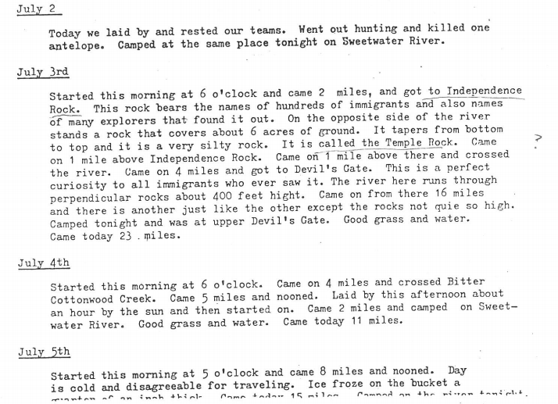
A typical journal looks like this:

Slide 11
4. Debrief
Capture words for 1800’s word wall.
Share great thinking by students you noticed when going around the room during work time.
Have students read aloud parts of the journal that they found interesting.
Make a connection back to the reading purpose established early in the lesson.
Keep one journal reserved as a mentor text for the class. Have students explain a section of this text.

Slide 12
Synthesis- “the combination of ideas to form a theory or system”
What role did Independence play in the Westward Movement? | What was life really like really for the pioneers?
Notes:
Use a graphic organizer for students to sort key ideas in order to form a conclusion on this time period. All students will have different experiences to read about so group discussion is very important.

Slide 13
Ideas for Culminating Project
Use Google Tour Builder to allow students to map out the journey of their pioneer, tagging locations with notable events or geographic features.
Host a living wax museum of pioneers.
Use a RAFT Generator to create interesting writing prompts- write a letter home convincing your relatives to join you- or convincing them to stay put!
Compare experiences of pioneers with textbook accounts. Prepare a more vivid and interesting textbook account of the Westward Movement.

Slide 14
Extensions to journal project

Slide 15
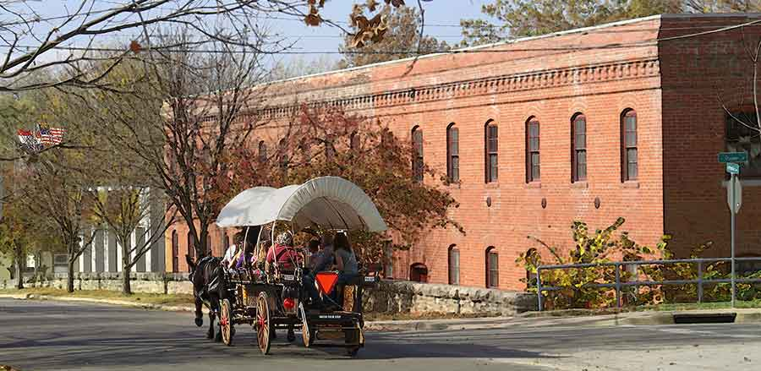
Take Field Trip to a location connected with this time period. Look for ways to make connections with local history.

Slide 16
Have students keep their own journal for an extended period of time.
Journaling is proven to:
Reduce Stress
Increase Goal Achievement
Benefit Personal Healing
Enhance Creativity
Journaling captures your story for the future

Slide 17
Journaling Project
Students will journal about their own lives for a month in class.
Time for journaling can be built in to the beginning or end of class.
Packet for journaling will be printed for you.
See if it is possible to send journals to a local archives.

Slide 18
Questions?
email: brian_schultz@isdschools.org

